Slide 1

Determinants and Consequences of Higher Education Expansion
Junyan Yao
Jan 30, 2017
Notes:
For this class project, I would like to rebuild the story why higher education expand so quickly in some countries or what are the possible economic outcomes of its expansion.

Slide 2
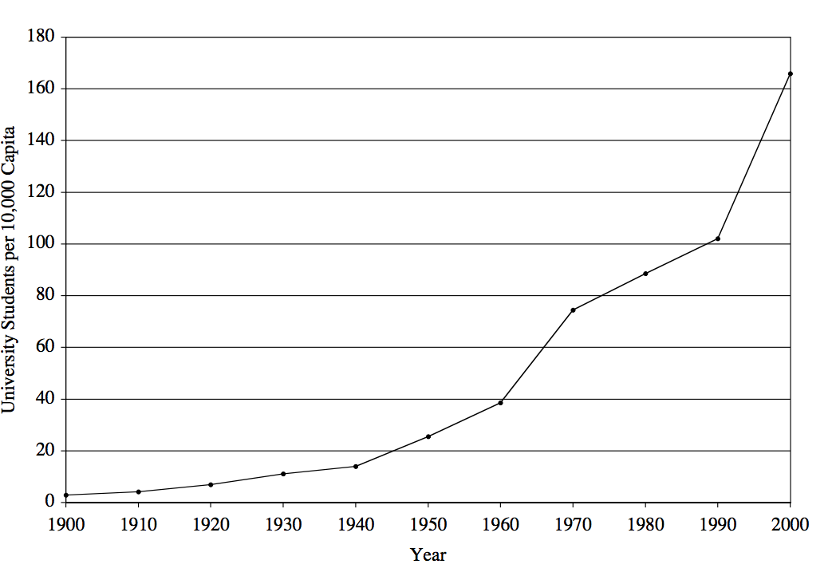
Introduction
What do you want to know?
Determinants and consequences of higher education expansion in one country, especially developing country
Specific question: where the expansion are mostly likely to occur?
Worldwide Higher Education Expansion
Notes:
As we can see from the right graph, by looking at the enrollment numbers in university, we can there is an obviously increasing trend over time. So this could bring us to one question: what could be the possible reason behind this? What are these consequeses after expansion. I have been doing some literature review recently. I see lots of descriptive analysis about this and short term quantitative data for similar topics. So I hope in this project, we can using longer term data to do the analysis.

Slide 3
Data
Panel data
Hopefully it would include data from 1980s to the present period;
Variables could include some economics indicator, such as average labor wage per capita; GDP per capita; Foreign Direct Investment per capita…
Variables could also include some demographics statistics, such as secondary school student-teacher ratio, population…
Variables could also include some higher education school information in the area, such as total number of higher education institutions, school type…
County level data

Slide 4
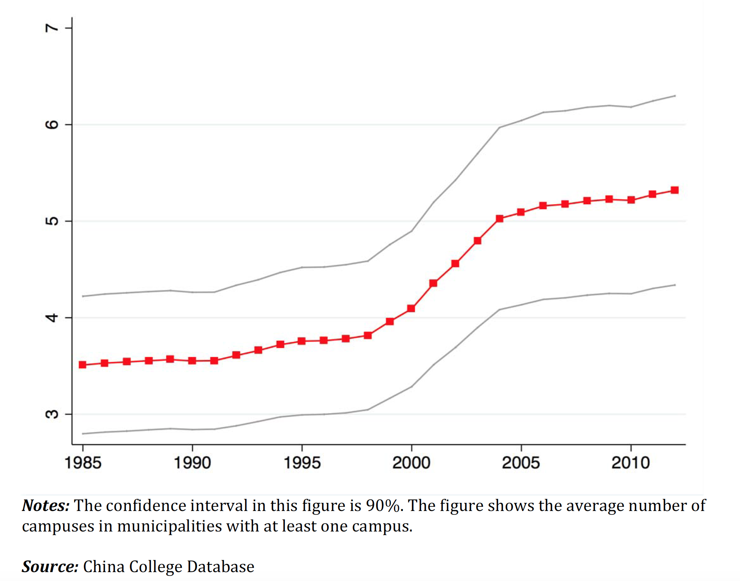
Example: Trends in the Average Number of Campuses Per Municipality in China
Notes:
Here is one example showing that there is an obvious increasing trends in the average number of campuses in China. We can the average number of campuses as the dependent variable.

Slide 5
Approach & Skills
OLS, Probit(very likely)
Clustering
Skills needed: clean and merge data; Regression analysis; Clustering methods;
A “success” could be that the clustering solutions are consistent with the demographics features.
Notes:
I am thinking the methods used here could be basic OLS regression and probit maybe.
Also, we can also do some clustering if we wants to study the feasures of expansion.
Because we have different kinds of possible variables. I think clean and merge data could be very annoying. After that, we can do several regression analysis and clustering analysis.
Right it is hard to tell how a success model would look like. One possible success could be that when the clustering solutions are consistent with the demographics features. For example, large cities colleges are in one group and smaller are in other group. Only a few overlapped points.

